Slide 1
Cell Membrane Engineering Project COFSP Culmination Event
Stacy Loushin
April 1st, 2016

Slide 2
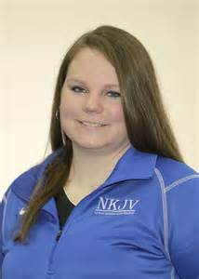
Introduction
5th year biomedical engineering major at the University of Cincinnati
COFSP Scholarship Recipient
Activity Implementation
Dixie Heights High School with Emily Hoffman
Biology A – 10th grade student
Stacy Loushin
COFSP Recipient
Emily Hoffman
RET Teacher

Slide 3
Unit Overview
Unit Overview
Cell Transport including simple diffusion and osmosis
Standards Identified
1. Explain how the cell membrane controls movement of substances both into and out of the cell and within the cell SC-HS-3.4.3 SC-H-UD-S-2
2. Explain how the cell membrane maintains homeostasis SC-HS-3.4.3 SC-H-UD-S-2
3. Describe and contrast these types of cell transport: osmosis, diffusion, facilitated diffusion, and active transport SC-HS-3.4.3 SC-H-UD-S-2

Slide 4
Activity Overview
Cell Membrane Engineering Project
Students were challenged to design and construct a working semi-permeable cell membrane
Activity Guiding Questions
What are the components of a phospholipid bilayer?
What is the difference between osmosis, diffusion, and facilitated diffusion in a cell?
How can you model a semi-permeable membrane?
What ways can you design and build a semi-functional model of the phospholipid bilayer?
Activity Objectives
Identify the different parts of a phospholipid bilayer
Define osmosis, diffusion, and facilitated diffusion
Model a semi-permeable membrane
Design and build a semi-functional model of the bilayer

Slide 5
Application, Career Connections and Societal Impact
Diffusion and Osmosis present in everyday life
Biology
Cell behavior
Plant survival
Medical care
Preservation and Dehydration of Food
Extremely prevalent in medical treatments
Senior capstone project involves treating excess oxygen in the body with microbubbles, utilizing concentration gradients

Slide 6
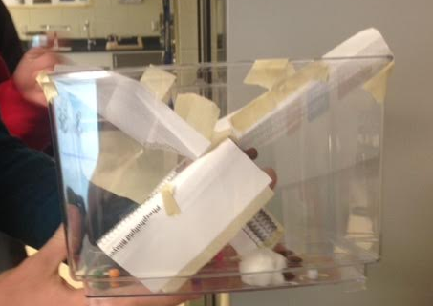
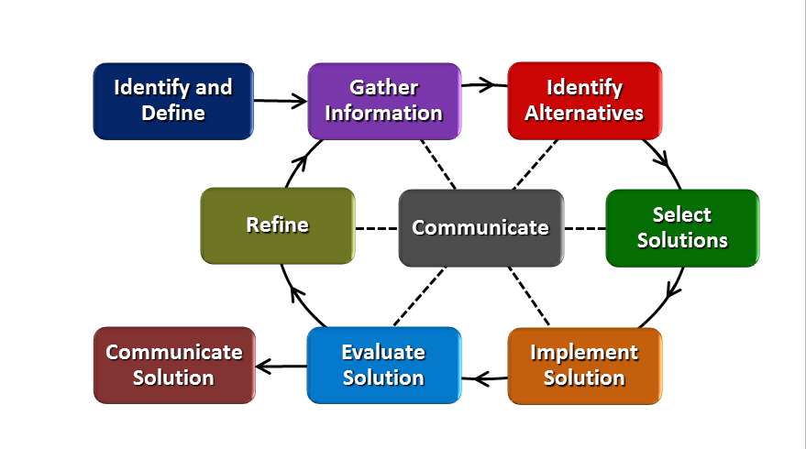
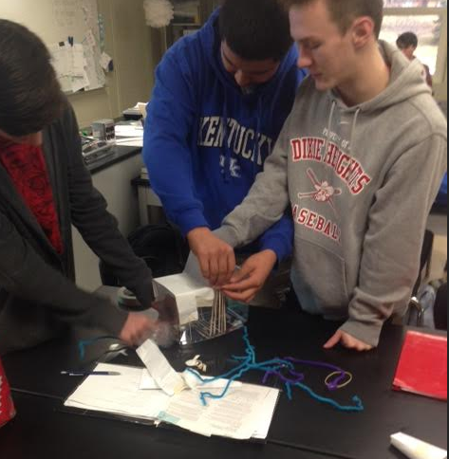
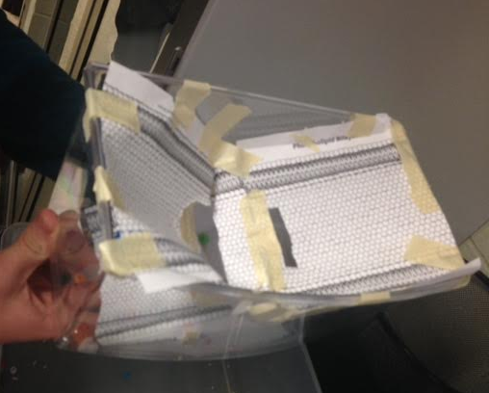
Activity Guidelines
Design a working semi-permeable membrane using:
Paper
Tape
Rubber bands
The membrane should be permeable to:
Cotton balls
Rice
Bingo Chips
Beans
The membrane should be impermeable to:
Marbles
Beads

Slide 7
Results: Pre vs Post Assessment
From pre to post assessment:
Average score increased 14.6%
Every question increased in correct answers
Question 1 more than doubled in number of correct answers

Slide 8
Activity Reflections
Activity Successes
Students fully cycled through the EDP
Majority of student involvement
Increased scores pre/post assessment
Activity Improvements
Implement activity over a 2 day period to allow for full redesign and testing
Assign materials names of particles that can and cannot go through membrane to increase understanding
Ex) Permeable molecules could be H₂O, O₂ etc.

Slide 9
Acknowledgements
The National Science Foundation
RET is funded by the National Science Foundation, grant #EEC -1404766.
Debora Liberi and Dr. Anant Kukreti
Emily Hoffman and Marie Inanli

